Slide 1
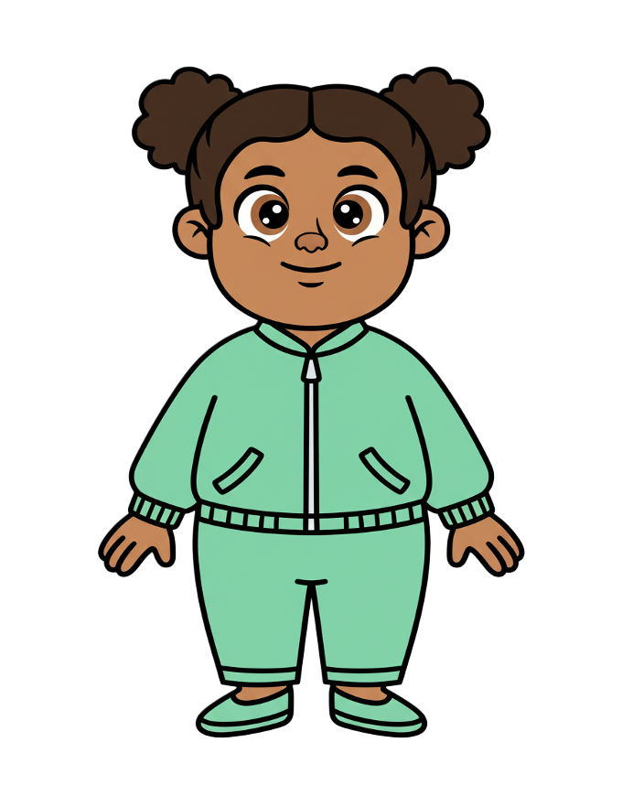
This is Zoe

Slide 2


Zoe has
Three cookies

Slide 3
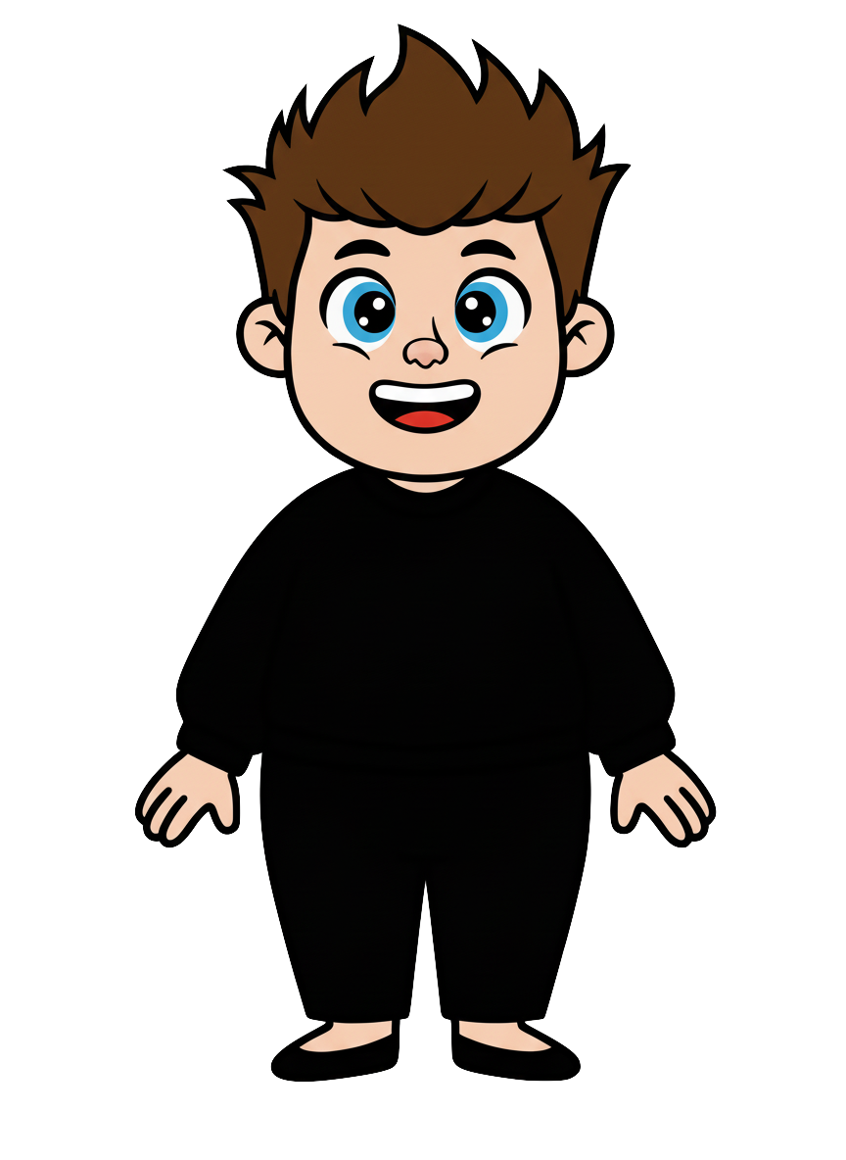
This is Rex

Slide 4
Rex has
three cookies

Slide 5
Rex wants Zoe to have fewer cookies.

Slide 6
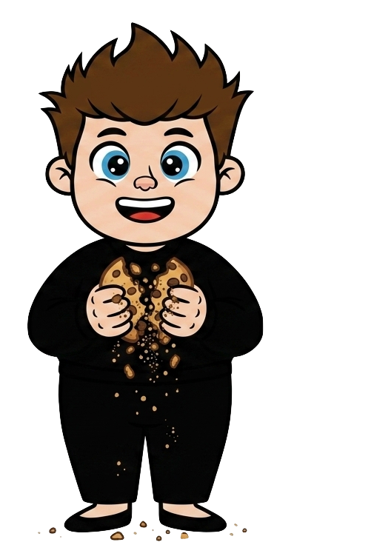
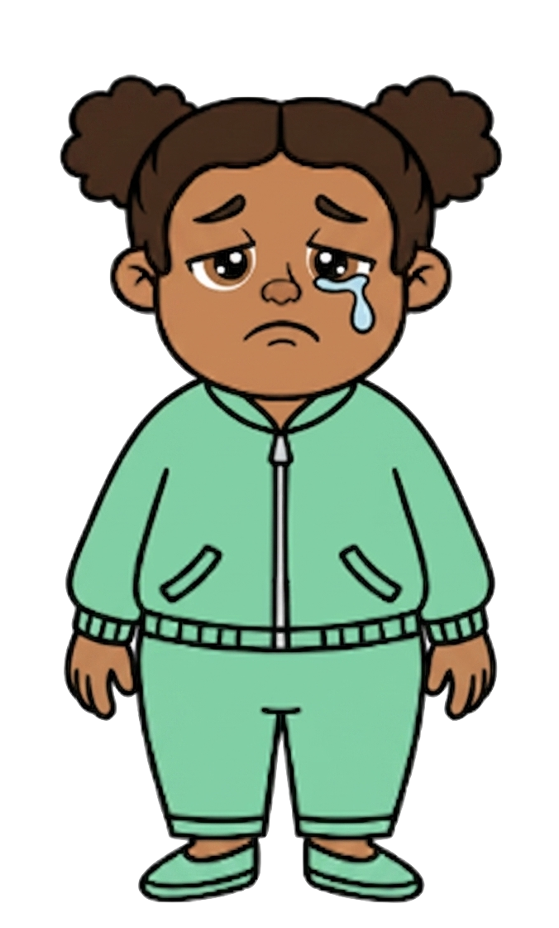
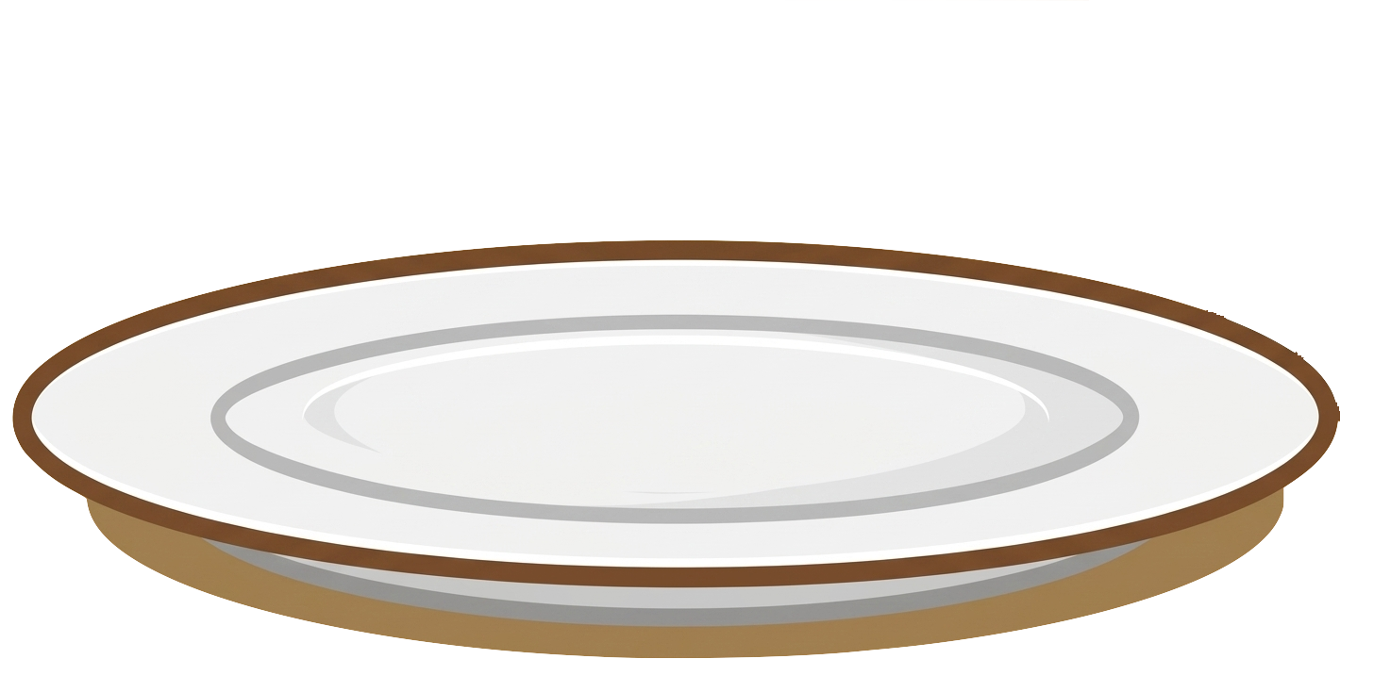
He deliberately knocks two of her cookies

Slide 7
Rex still has 3 cookies. Zoe now has 1 cookie.

Slide 8
Please decide whether you would like to move some of Rex’s cookies.

